Slide 1
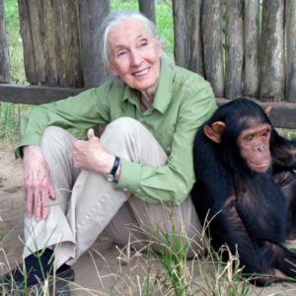
Dr Jane Goodall’s Visit to St Catherine’s School.
May 10th 2019

Slide 2
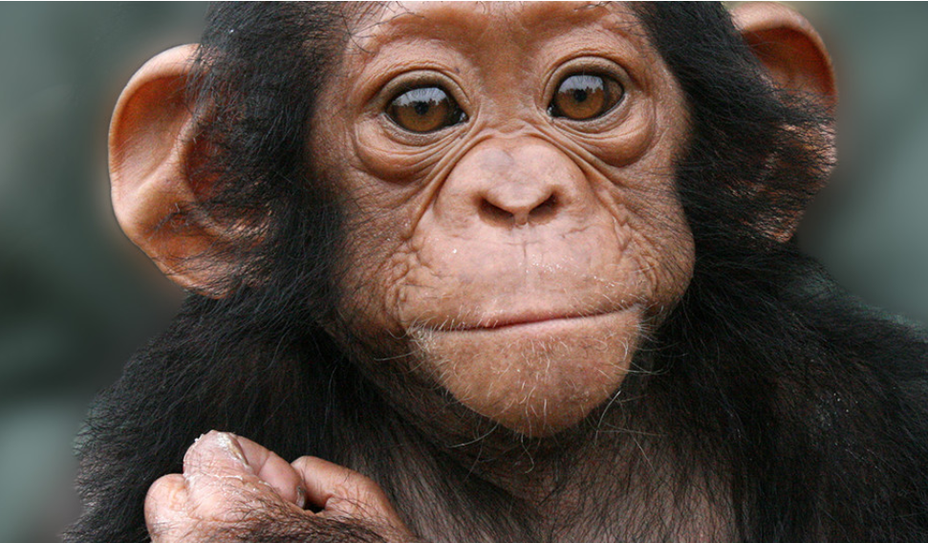
Dr Jane Goodall’s work now revolves around inspiring action on behalf of endangered species and encouraging people to do their part to make the world a better place for animals, people and our shared environment.
She is the founder of the Jane Goodall Institute and the Roots & Shoots program, and she has worked extensively on conservation and animal welfare issues.

Slide 3
Dr Jane Goodall is visiting St Catherine’s School on Friday 10th May. We are the only school in Victoria that she is visiting, so are very fortunate.
Sarah Triolo (Charlotte Triolo's mother 2I) volunteers for the Roots and Shoots foundation as the State Coordinator and has been instrumental in providing us with this opportunity.
Prior to Dr Goodall’s visit (please refer to her as Dr Goodall or Dr Jane) there will be some activities to enhance our students’ understanding of Dr Goodall’s inspirational work.

Slide 4
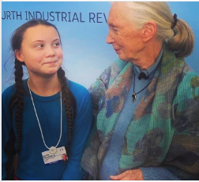
RESOURCES
Highly recommended viewing (some chimp fighting not appropriate for children)- https://www.netflix.com/au/title/80216161
https://rootsandshoots.org.au/
This includes classroom activities linked to the Australian Curriculum
www.janegoodall.org.au
Timeline of Dr Jane Goodall’s life
https://www.janegoodall.org.au/about-dr-jane-goodall/#eluid1aabb129
Roots & Shoots have teamed up with Cool Australia and developed Roots & Shoots lesson plans for the lower primary (https://www.coolaustralia.org/unit/roots-shoots-investigating-habitats-lower-primary/) and upper primary (https://www.coolaustralia.org/unit/roots-shoots-focus-on-consumption-upper-primary/)
https://www.facebook.com/aplus/videos/274309656797553/
Books about Jane Goodall – please see Library resources
Greta Thunberg and Dr Jane

Slide 5
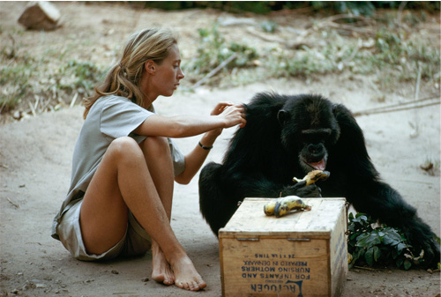
About Dr. Jane
Background
In July 1960, at the age of 26, Jane Goodall travelled with her mother to Gombe Stream National Park in what is now Tanzania and courageously entered the mysterious world of wild chimpanzees. She was equipped with little more than a notebook, binoculars, optimism and desire to learn more about these incredible animals.
Through patience and persistence, she won the trust of the chimpanzees and eventually learnt more than anyone else on earth ever had about our closest living relatives. The public was fascinated by her findings, which changed the way that we look at evolution and ourselves forever.

Slide 6
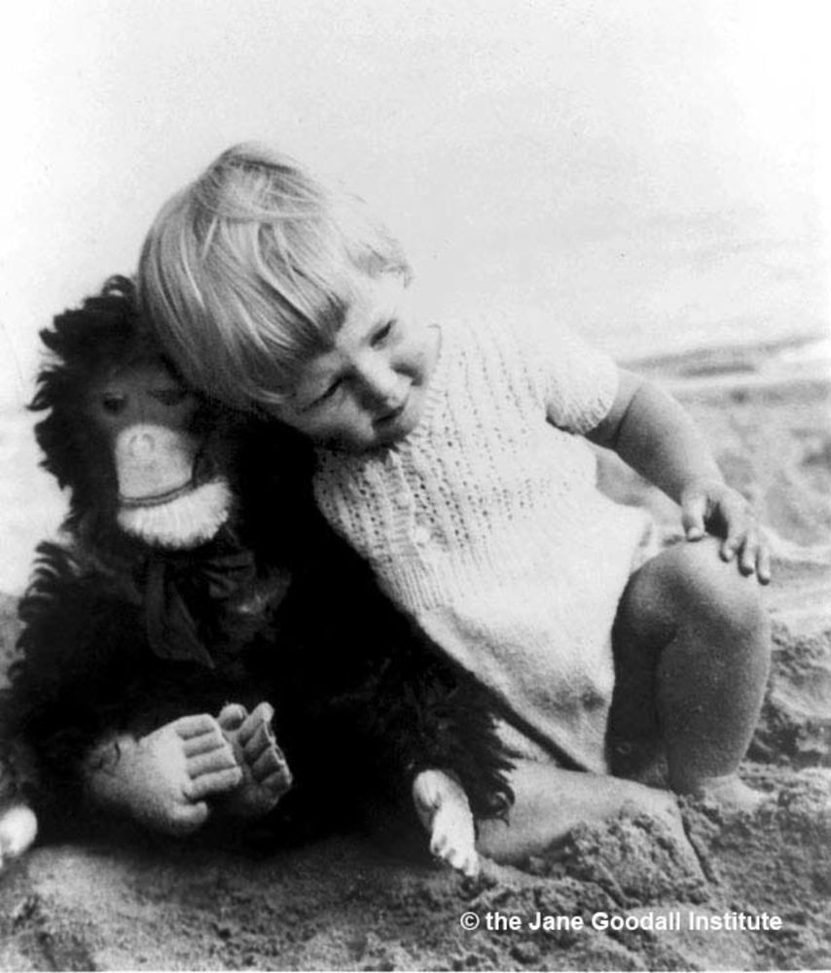
As a child living in England, Jane was given a life-like stuffed chimpanzee toy named Jubilee by her father. Her love for the toy sparked her early joy for animals. Today, Jubilee still sits on her dresser in London as a reminder of her desire to explore the unknown. Her love of living creatures was always apparent to everyone around her and since Tarzan was her favourite book, it was clear to a young Jane that this was her journey. However in the 1950’s, it was not an easy path to be a girl with a dream to explore, travel and be a scientist. Luckily Jane was determined and worked as a waitress until she had saved enough money for a ticket and off she went to explore the jungles of Africa.
The Jane Goodall Institute Australia works to protect the chimpanzees of Africa, their habitat and surrounding communities. They do this through community-centred conservation and sanctuaries in our Africa Programs and inspiring young people to make a difference in our Roots & Shoots program.
Roots & Shoots was started by Dr Jane and a group of students in Tanzania in 1991. Today Roots & Shoots has nearly 150,000 members in more than 140 countries.

Slide 7
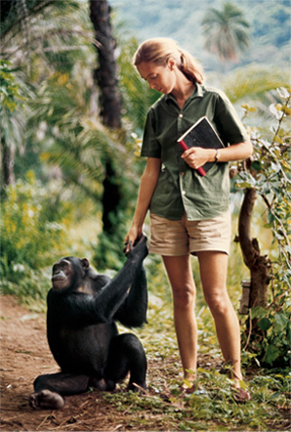
Dr Goodall is now 85 years old and with 58 years of experience in studying, living with and fighting for chimpanzees. She now travels more than 300 days a year to educate and speak to people about animal, people and our shared environment.
She is now known around the world as a Dame, UN Messenger of Peace, conservationist, primatologist, ethologist, anthropologist and the world’s foremost expert on chimpanzees but she remains at heart a young girl with a dream.

Slide 8
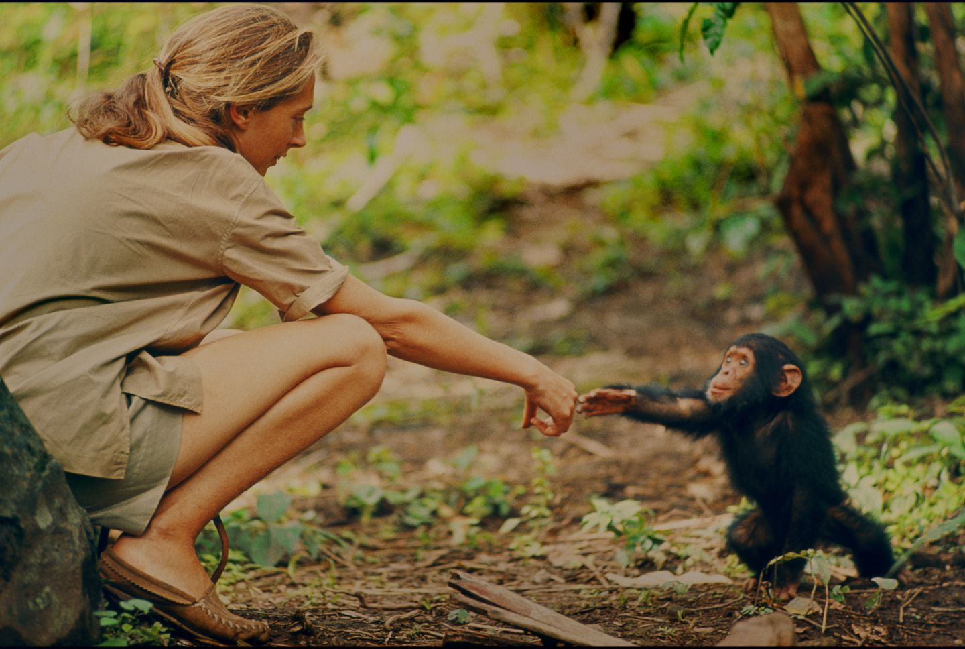
“You cannot get through a single day without having an impact on the world around you. What you do makes a difference, and you have to decide what kind of difference you want to make.”
― Jane Goodall

