Slide 1
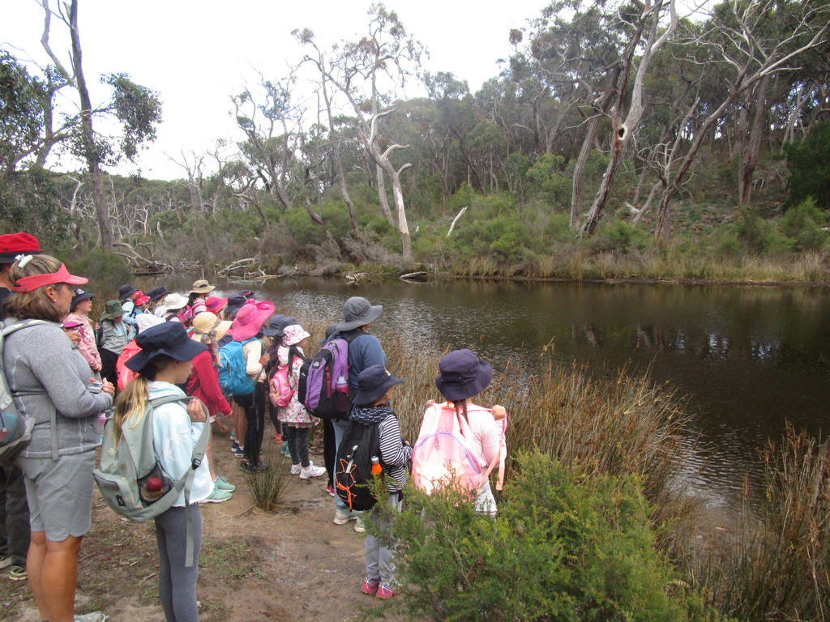
Camp Year 4 Term 1 2018
By Rose Sumithran

Slide 2
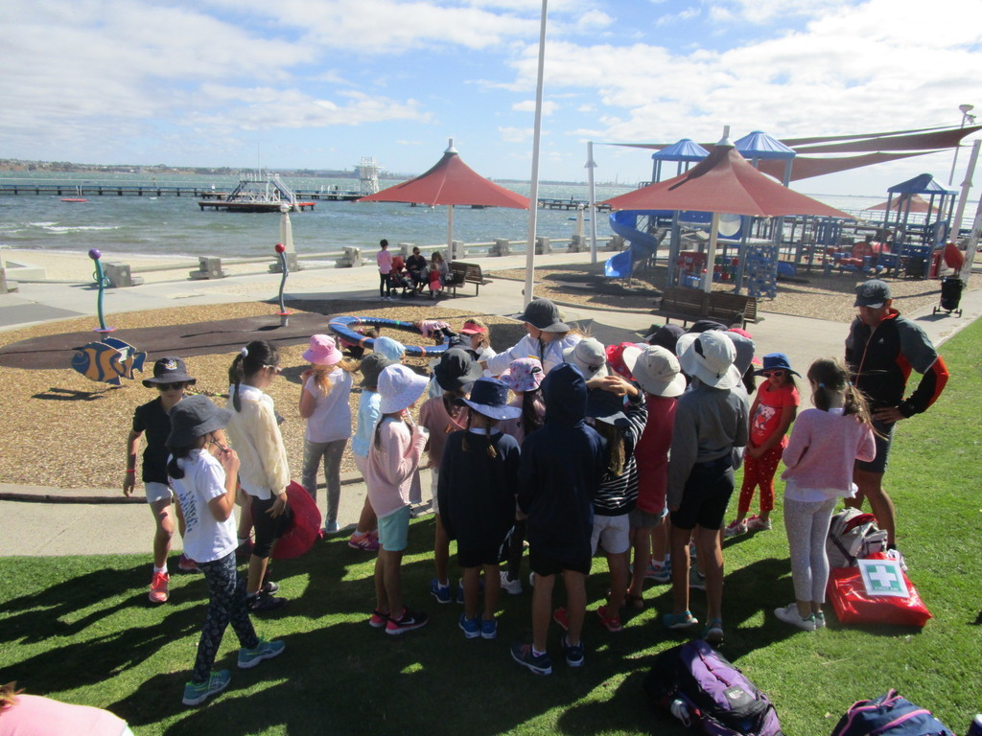
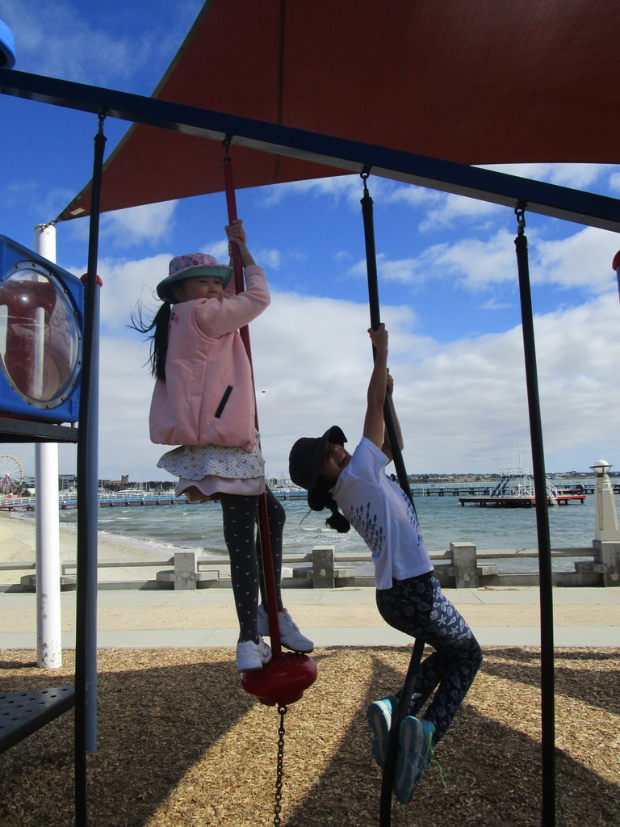
camp
We went in the bus to Eastern Beach. I sat next to Anna. Once we arrived there we ate our snack. After eating our snack we had to put sunscreen. Then we were allowed to go and play on the playground.

Slide 3
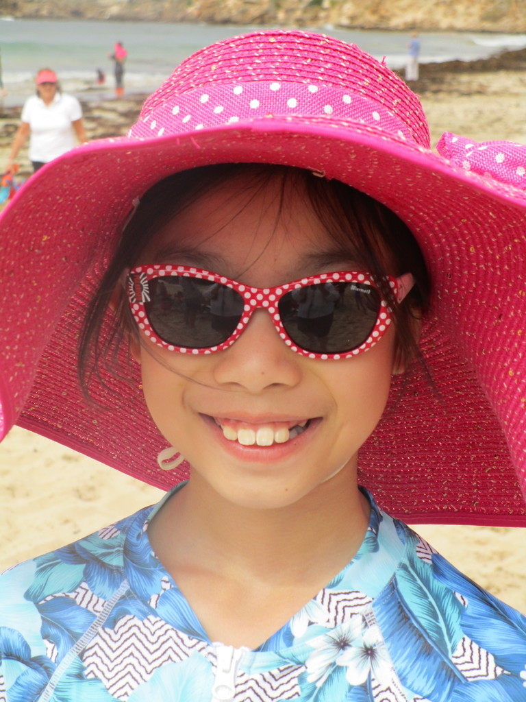
At Anglesea….
We did Iron girl and made sandcastles , but didn’t get to do the sandcastle competition. This a picture with my best friend Anna.

Slide 4
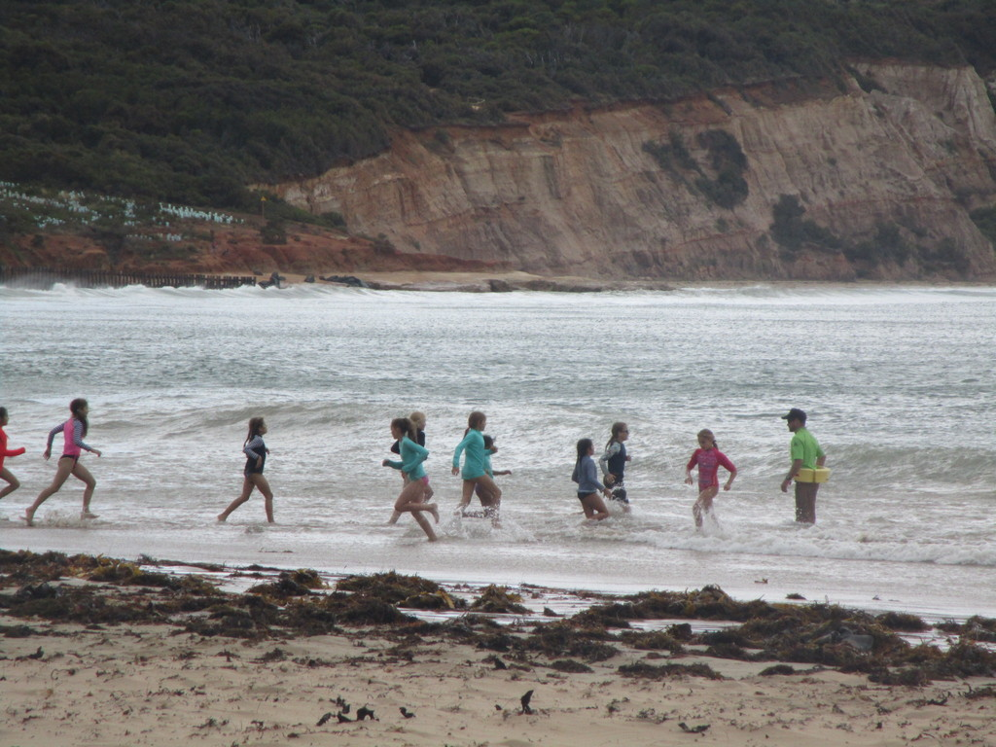
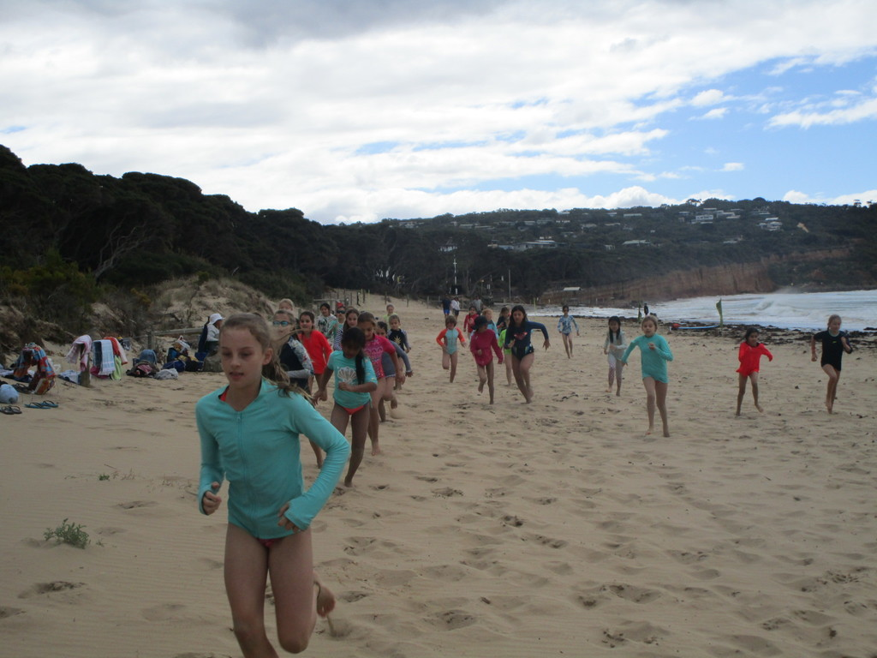
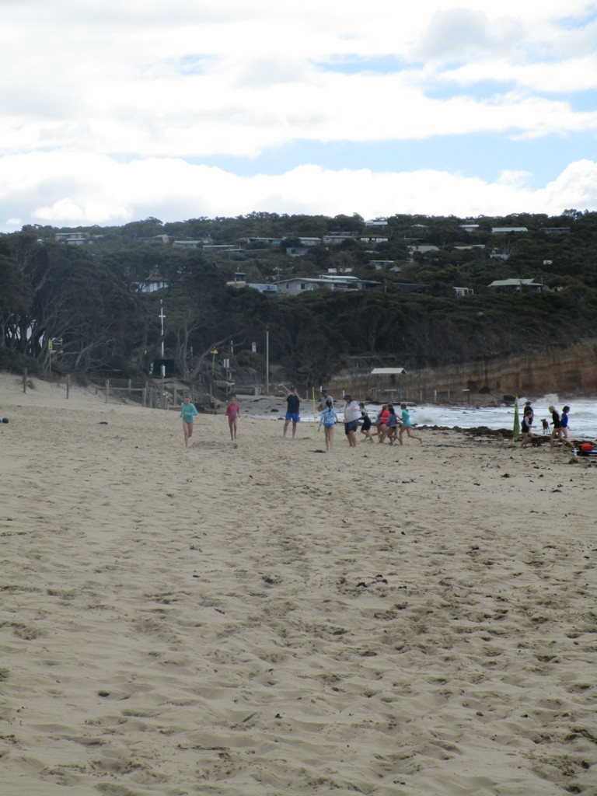
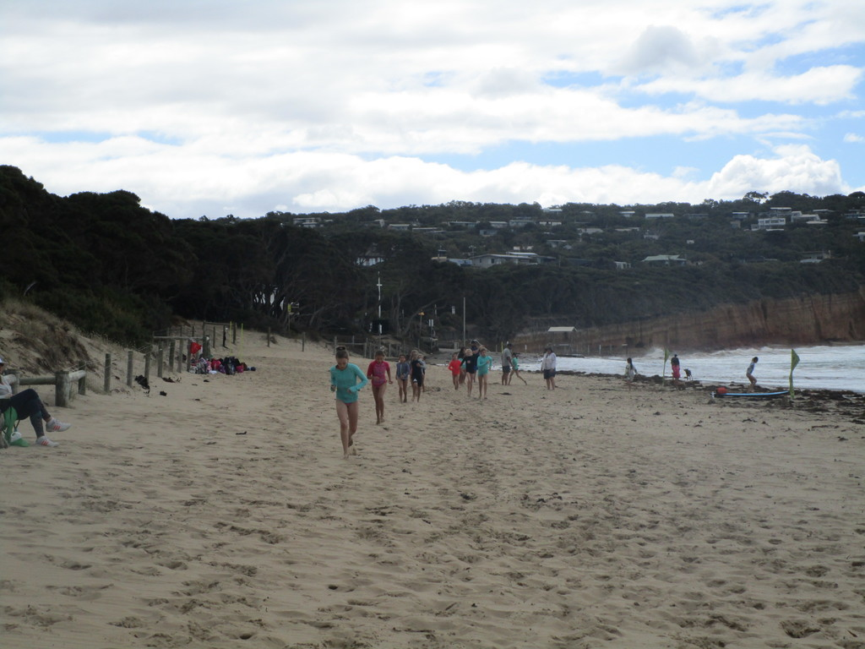
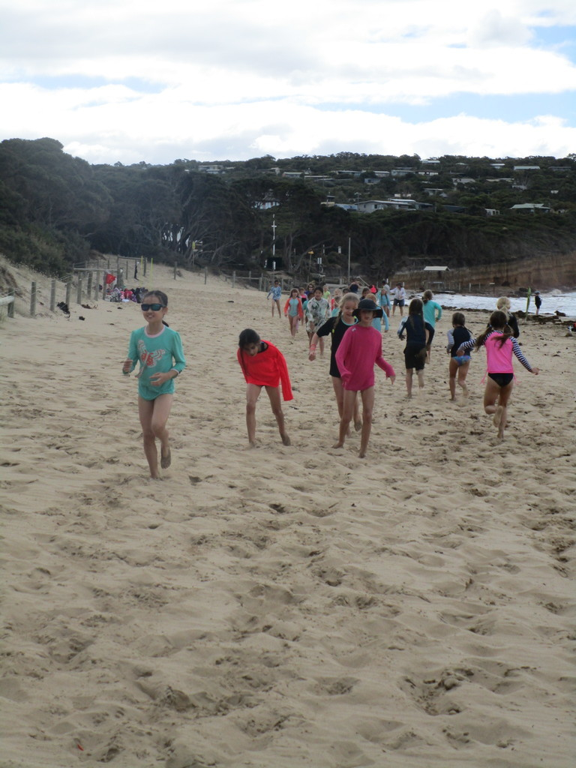
Iron girl
We did Iron girl.
15th
place
I I got really tired.

Slide 5
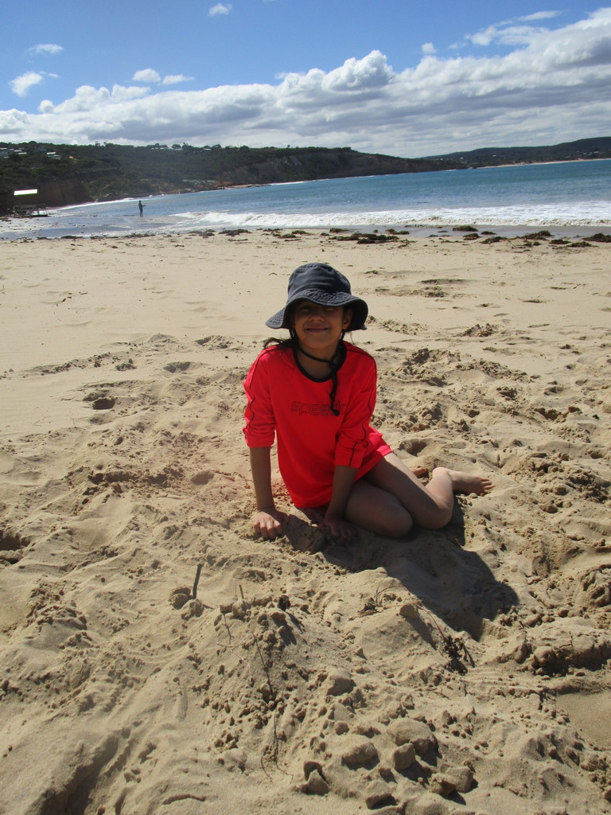
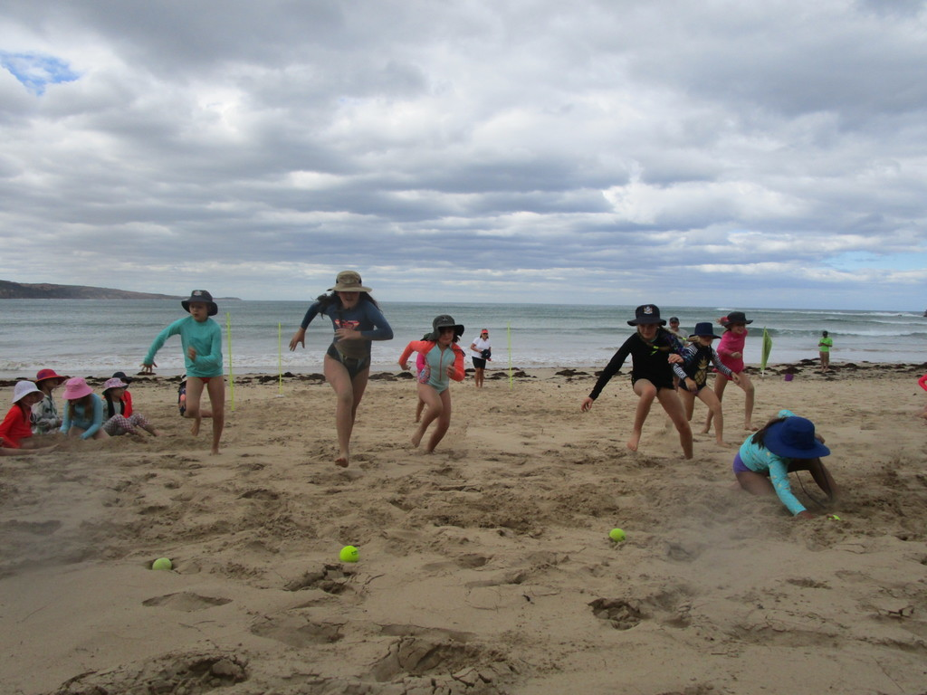
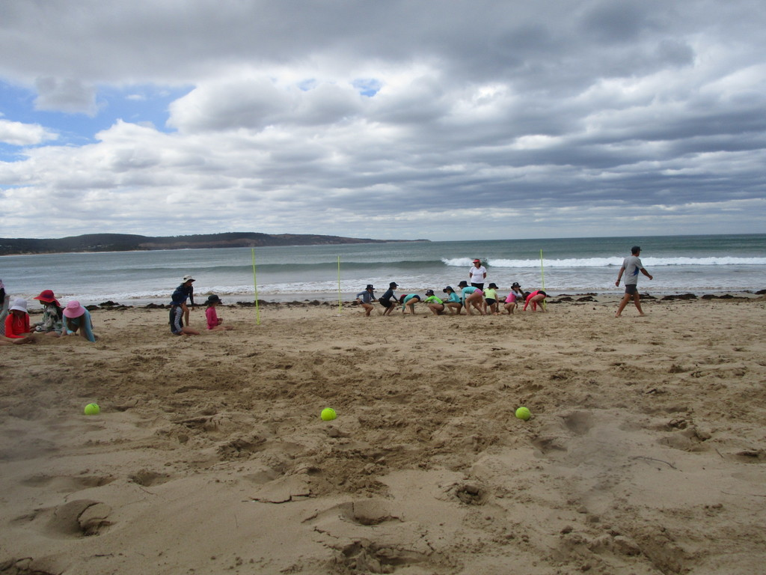
Flags
We played a game called flags. You’re supposed to go on your tummy chin and look at the sea. When the whistle blows you turn around and run and grab the tennis ball. You might not be able to get the tennis ball. Who ever gets the tennis ball will get to go in the next match while the people who didn’t get the tennis ball get behind the fluro green pole. They can make a sand castle if they want. I didn’t get to grab the tennis ball. Same for Anna and Minnie.

Slide 6
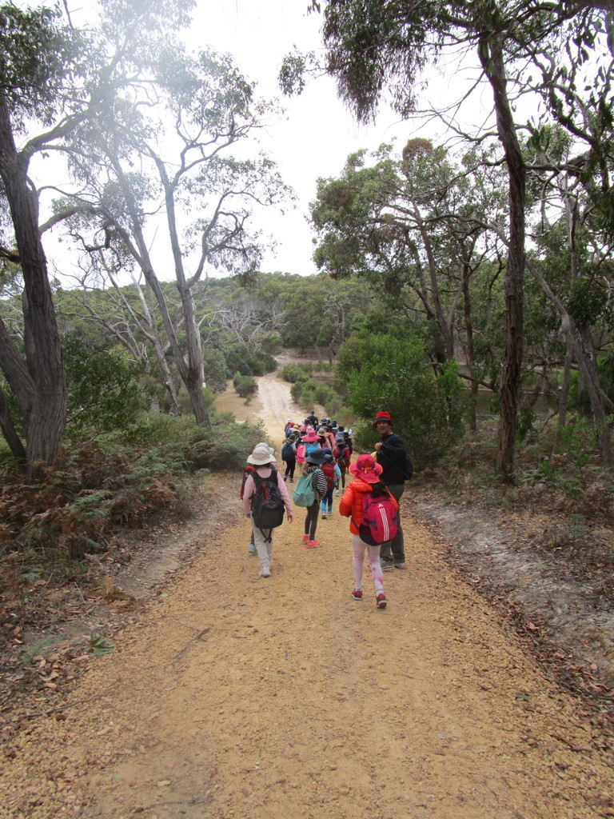
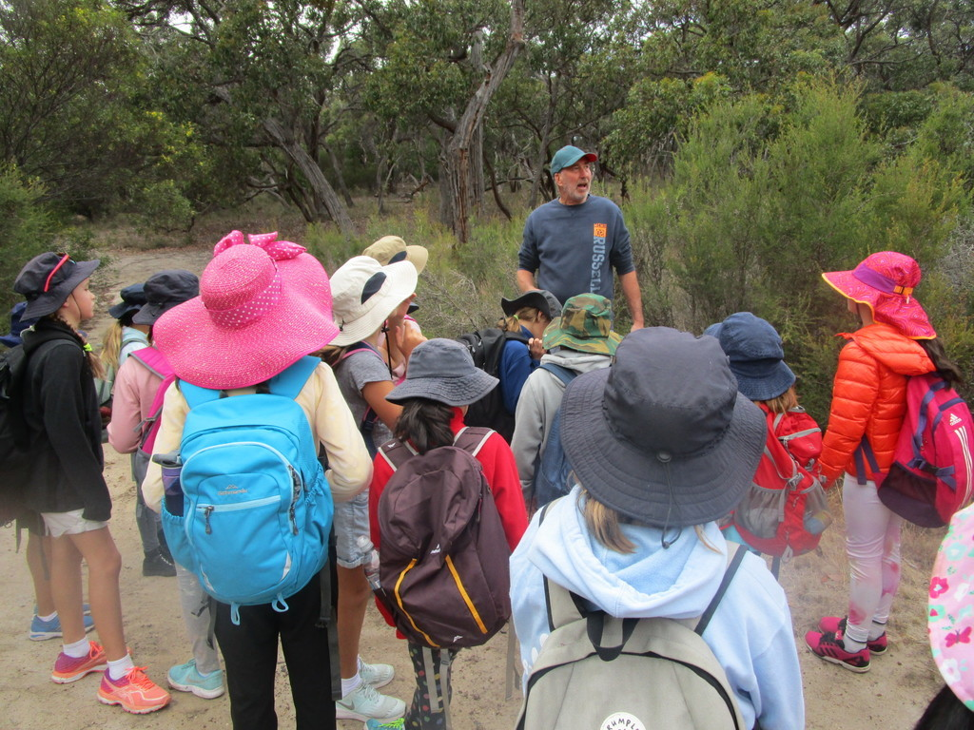
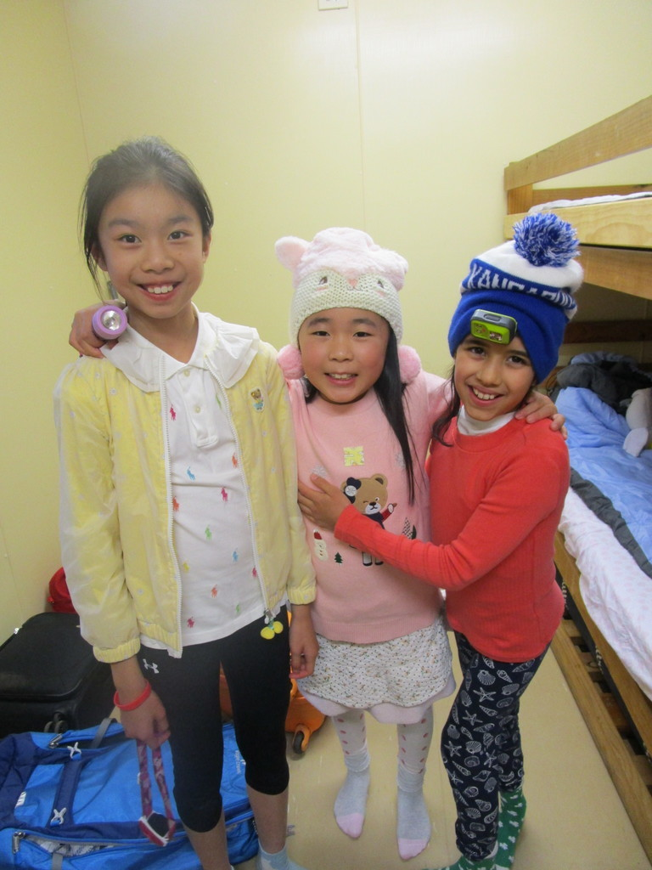
Coastal forest lodge
We went to Coastal Forest Lodge and met Iona. We did lots of activities. We got to know our cabin name. Our cabin name was Los Angeles. In the room of the cabin that I was in, it had 2 other people. Minnie and Anna. My best friends. We had walks spotting birds. Indigicate. 3 mini activities mini golf + Archery. Spotting places at camp. Anna and I spotted 7. I was champion at archery. I hit the red bit of the target. Last off all of the mini activities was origami butterflies.

Slide 7
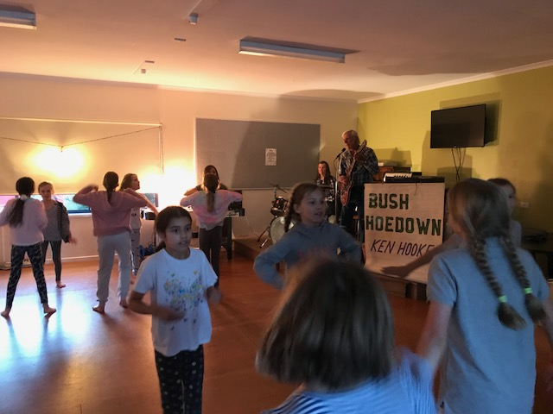
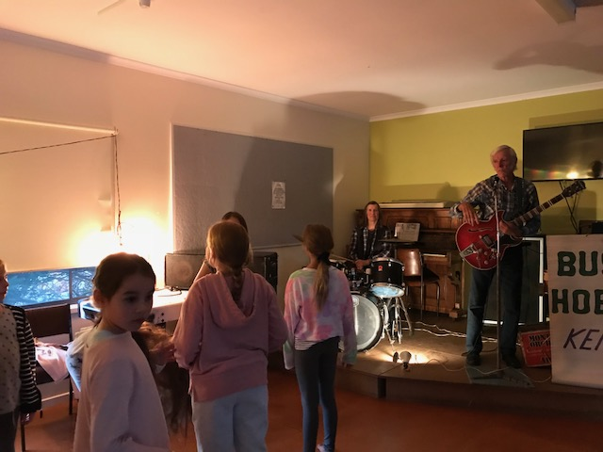
Bush dancing
Bush dancing was one of my favourite activities. We first did the duck dance. Quack , quack , quack , flap , flap , flap , waddle , waddle , waddle , clap ,clap , clap. Right arm swing. Left arm swing. Go forwards go backwards now put your partner's hands up and put them together. Then the front people go under the arms. It was really fun.

Slide 8
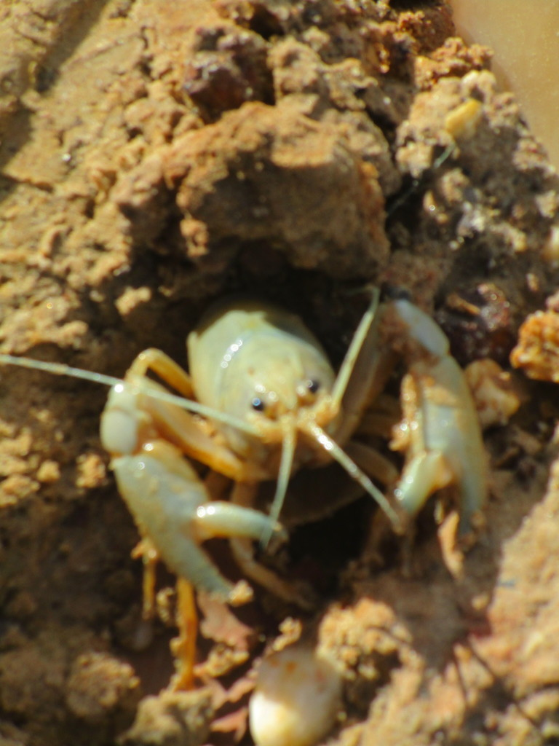
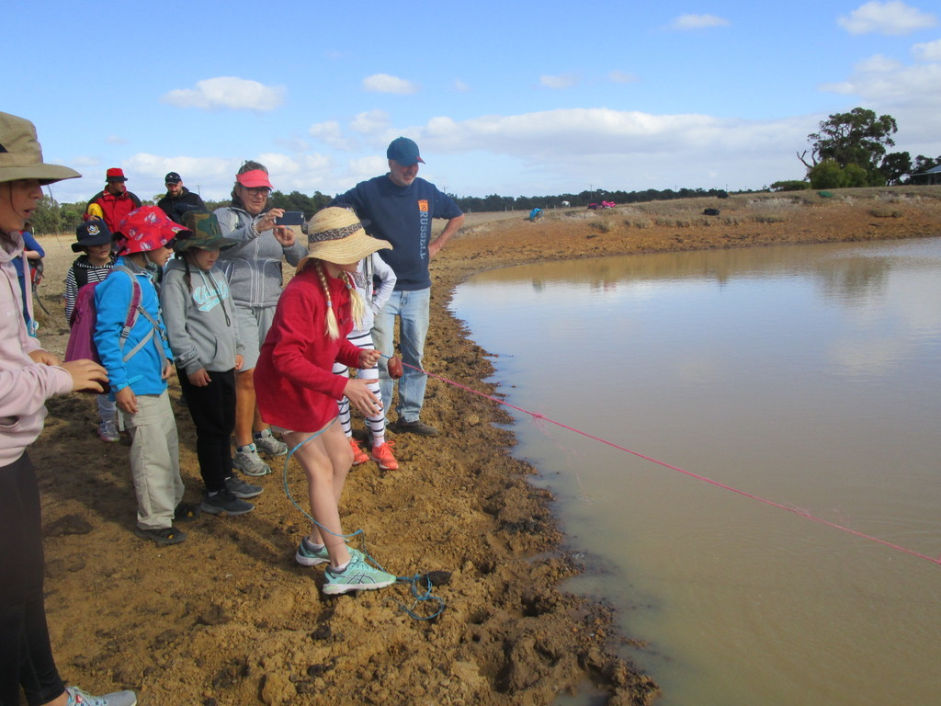
Yabby
At camp we got to catch yabbies with a net. We also got to hold them. Anna and I didn’t but I tried to. But it was wriggling, trying to stop me from holding it. But I got to touch it.

Slide 9
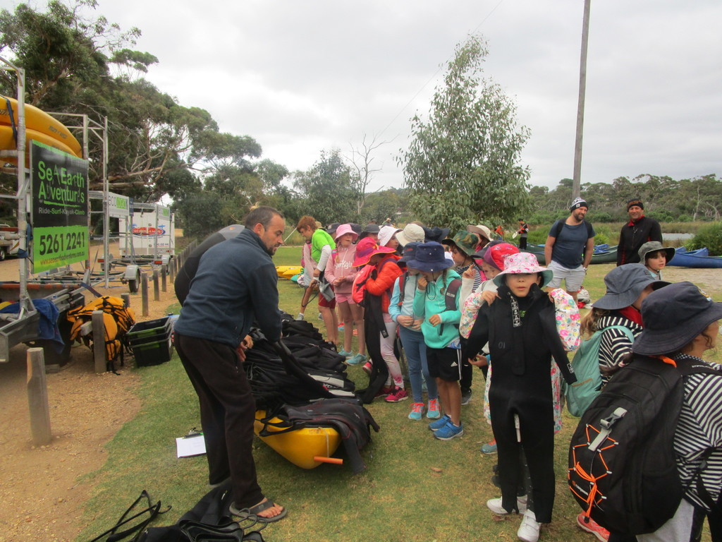
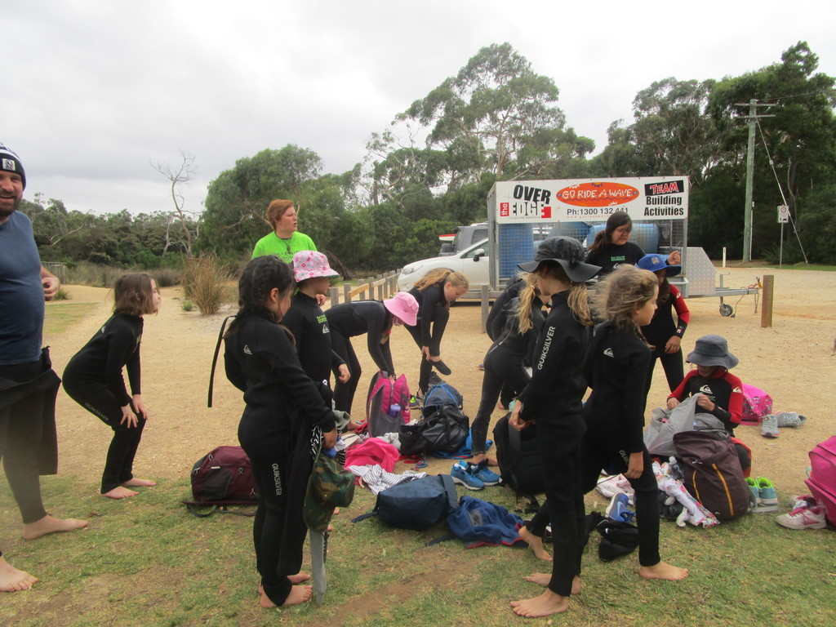
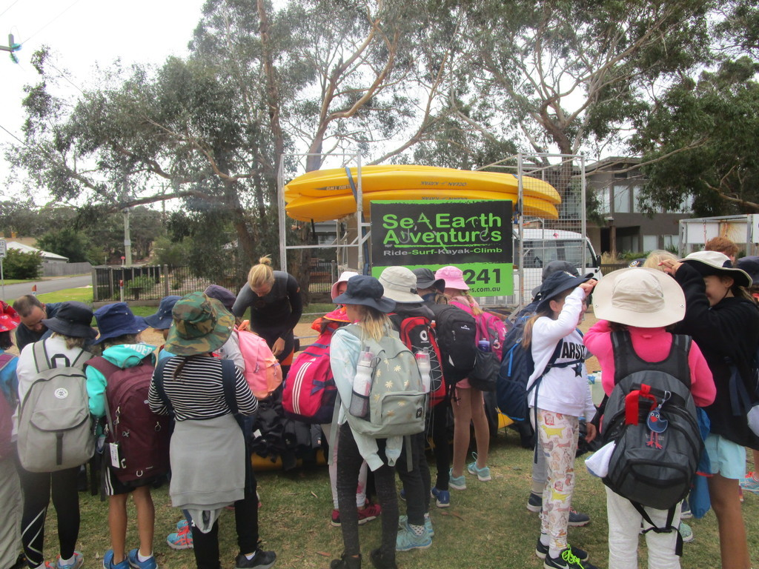
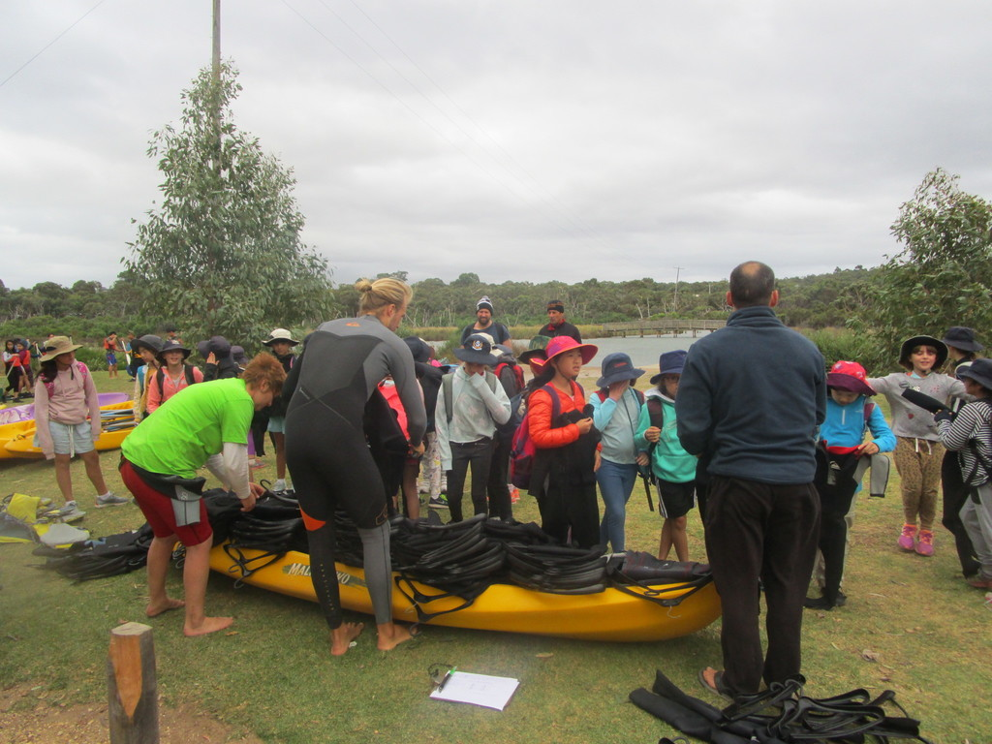
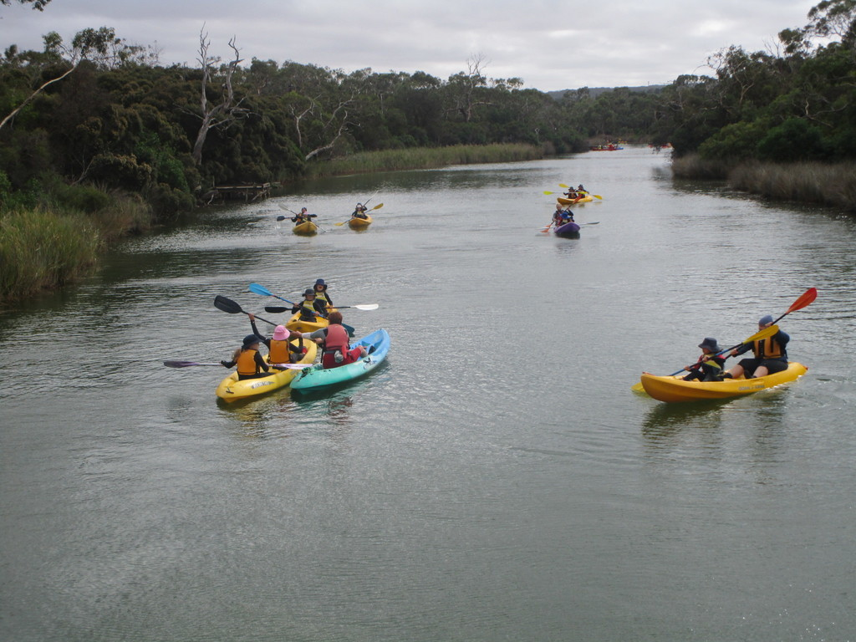
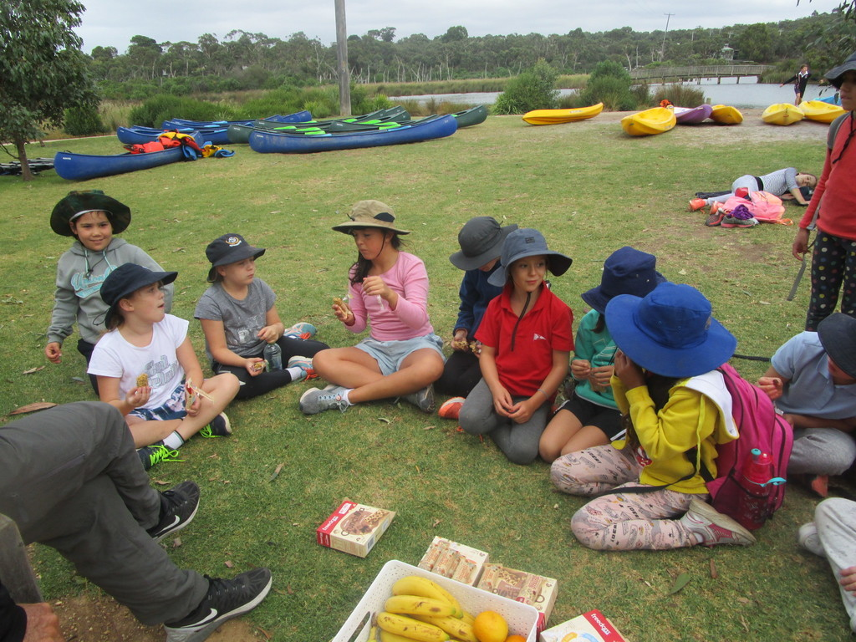
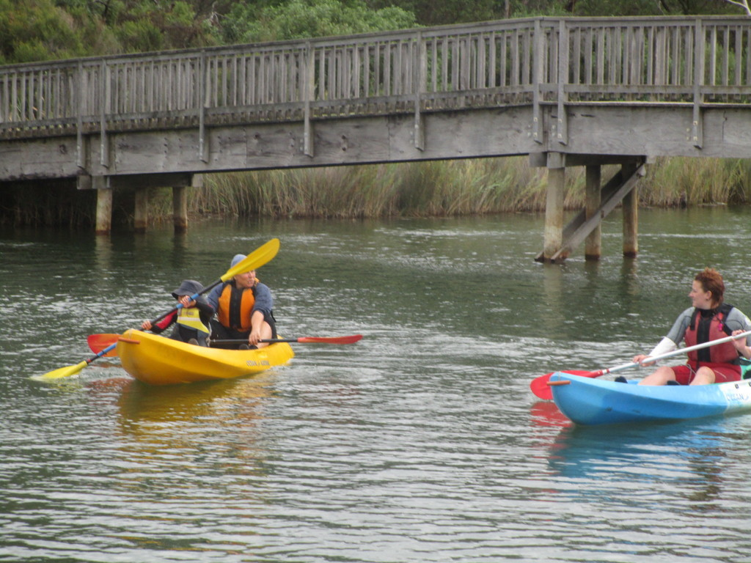
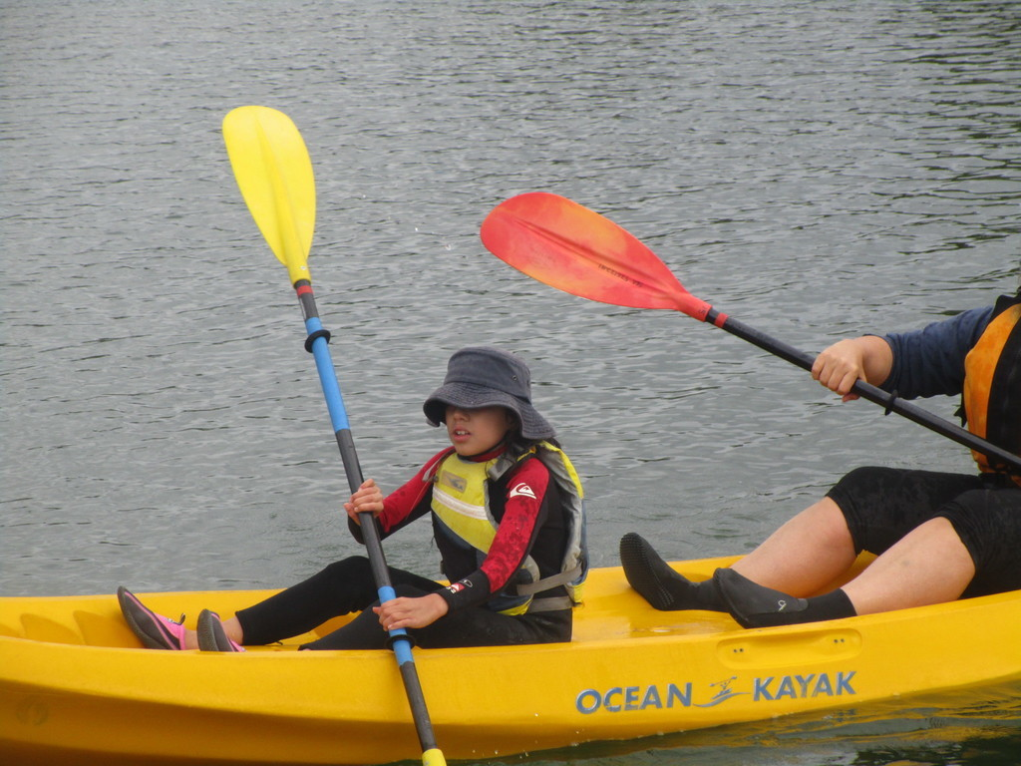
Kayaking
This activity was really fun. We put on wet suits and a PDF. Then we learnt how to use the paddle. Then there was a demonstration by Harper and Giselle U. I was so excited until we got into the water doing kayaking. I was partners with Ms Schilte. Ms Schilte was on the back of the boat and I was at the front. We had lots of fun. We played zombie tag and colour tag. We were supposed to not get tagged by the other boats.

Slide 10
Thankyou Ms Schilte, Ms Stride, Mr Russell and all the people who had a great time with us. We loved it.
Thankyou

